Slide 1
HIRING PROCESS ANALYTICS
Hiring process is the fundamental and the most important function of a company. We look at trends like number of positions, how many were hired/rejected, their salaries, etc. In this project we will be working for a MNC such as Google in analysing those data and run queries to get our answer to certain questions.
Hiring: How many males and females are Hired?
Average Salary: What is the average salary offered in this company?
Class Intervals: Draw the class intervals for salary in the company?
Charts and Plots: Draw Pie Chart / Bar Graph (or any other graph) to show proportion of people working different department?
Charts: Represent different post tiers using chart/graph?

Slide 2
APPROACH
Download the dataset
Approach the solution by performing MS Excel formulas.
Analyse the solutions.
Note them down.
TECH-STACK USED
MS-EXCEL 2013

Slide 3



INSIGHTS
A. How many males and females are Hired ?

Slide 4
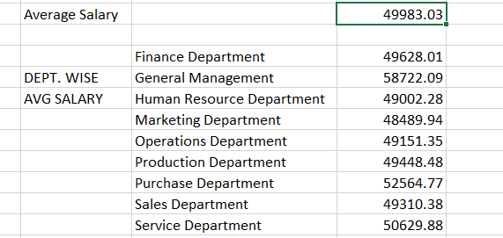
B.What is the average salary offered in this company?
Firstly, I did calculate the average salary i.e. sum of offered salary/ count of offered salary.
Secondly, I calculated the average salary Dept. Wise.
=AVERAGEIF(E2:E7168,"Finance Department",G2:G7168)
=AVERAGEIF(E2:E7168,"General Management",G2:G7168)
Like this I calculated the rest of the dept. salary using averageif function.

Slide 5
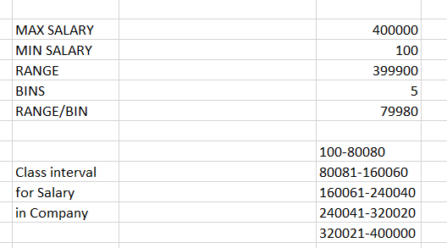
C.Draw the class intervals for salary in the company ?
Firstly, I found the MAX and MIN salary offered and then found the range i.e. MAX-MIN after that I thought of making 5 class intervals so I divided the range by 5 and got the answer for the range increment.
After that I use CONCATENATE function LEFT and RIGHT function to achieve the desired class interval.
Formula I used:
=CONCATENATE(K23,"-",K23+K26) for 100-80080
=CONCATENATE(RIGHT(K28,5)+1,"-",RIGHT(K28,5)+K26) for 80081-160060
=CONCATENATE(RIGHT(K29,6)+1,"-",RIGHT(K29,6)+K26) for 160061-240040
=CONCATENATE(RIGHT(K30,6)+1,"-",RIGHT(K30,6)+K26) for 240041-320020
=CONCATENATE(RIGHT(K31,6)+1,"-",RIGHT(K31,6)+K26) for 320021-400000

Slide 6




















D. Draw Pie Chart / Bar Graph (or any other graph ) to show proportion of people working different department?
Formula used:
=COUNTIFS(E2:E7168,"Finance Department",C2:C7168,"Hired")
=COUNTIFS(E2:E7168,"General Management",C2:C7168,"Hired") Just providing 2 formulas to let you know the way I did it.
No.of employees | Department
176 | Finance Department
113 | General Management
70 | Human Resource Department
202 | Marketing Department
1843 | Operations Department
246 | Production Department
230 | Purchase Department
485 | Sales Department
1332 | Service Department
2000
1800
1600
1400
1200
1000
800
600
400
200
0
No.of employees
1843
No.of employees
1332
485
176
113
70
202
246
230

Slide 7

















E. Represent different post tiers using chart/graph? Formula used:
=COUNTIFS(F2:F7168,"b9",C2:C7168,"Hired")
=COUNTIFS(F2:F7168,"c-10",C2:C7168,"Hired")
Again just providing 2 formulas to let you know the way I did it.
Post Name | No. of employees
b9 | 308
c-10 | 105
c5 | 1182
c8 | 193
c9 | 1239
i1 | 151
i4 | 32
i5 | 511
i6 | 337
i7 | 635
- | 1
m6 | 2
m7 | 0
n10 | 0
n6 | 1
n9 | 0
NO. OF EMPLOYEES
1182
1239
Axis Title
511
635
308
105
193
151
32
337
1 2 0 0 1 0
b9 c-10 c5 c8 c9 i1 i4 i5 i6 i7 - m6 m7 n10 n6 n9
Post Names

Slide 8
RESULT
In the end I learned a lot about MS-Excel from this project for example learned about CONCATENATE function usage also LEFT and RIGHT function usage and also learned about graph in a detailed manner. I enjoyed doing this project.

Slide 9
THANK YOU
-AYUSH YADAV

